Slide 1

Computer Organization and Assembly Language (CS2523)
Department of Computer Science,
Capital University of Science and Technology, Islamabad
Fall Semester, 2022

Slide 2
Lecture Outlines
Welcome to Assembly Language
Applications of Assembly Language
Assembly Language Comparison
Programmer’s View of a Computer System/ Virtual Machine Concept
General Concepts of a sequential architecture/ Instruction Cycle

Slide 3
Welcome to Assembly Language(AL)
Oldest programming languages of all languages
Provides direct access to computer hardware
AL programmer knows a great deal about the computer architecture and OS(operating system)

Slide 4
Welcome to Assembly Language(AL)
Assembler
A program that converts an AL source code program to machine language
Popular Assemblers
MASM (Microsoft Assembler)
EMU8086 (Microprocessor Emulator)
TASM (Borland Turbo Assembler)
NASM (The Netwide Assembler)

Slide 5
Welcome to Assembly Language(AL)
Software/Hardware Need
Editor
Text Editor for creating source files
Assembler
Linker
Linker utility is required to produce executable file using libraries
E-g; link32.exe
Debugger
For debugging/profiling of the program(errors detection/correction)
CodeView for MASM
Advanced Full Screen Debugger (AFD) for NASM

Slide 6
Welcome to Assembly Language(AL)
How does assembly language (AL) relate to machine language?
How do C++ and Java relate to AL?
Is AL portable?
Notes:
Things that are not allowed in Assembly Language are also not allowed in Machin Language. One to One mapping, which means that a program shall have equal lines of code of AL and ML.
Assembly Language is Machine Specific and is not portable. Each Machine will have different AL code.

Slide 7
Assembly Language Applications
Business application for single platform
Hardware device driver
Business application for multiple platforms
Embedded systems & computer games

Slide 8
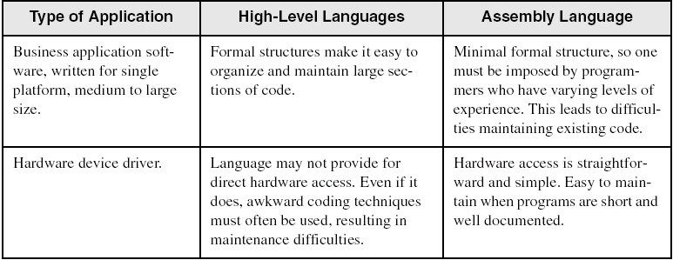
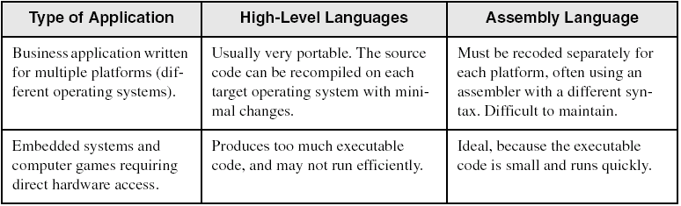
Assembly vs High-Level Languages
Some representative types of applications:

Slide 9
Programmer’s View of a Computer System A Concept by Tanenbaum Virtual Machine Concept
Increased level of abstraction
Application Programs
High-Level Language
Level 5
Assembly Language
Level 4
Operating System
Level 3
Instruction Set
Architecture
Level 2
Microarchitecture
Level 1
Each level hides the details of the level below it
Digital Logic
Level 0

Slide 10
Programmer's View
Application Programs (Level 5)
Written in high-level programming languages
Such as Java, C++, Pascal, Visual Basic . . .
Programs compile into assembly language level (Level 4)
Assembly Language (Level 4)
Instruction mnemonics are used
Have one-to-one correspondence to machine language
Calls functions written at the operating system level (Level 3)
Programs are translated into machine language (Level 2)
Operating System (Level 3)
Provides services to level 4 and 5 programs
Translated to run at the machine instruction level (Level 2)

Slide 11
Programmer's View
Instruction Set Architecture (Level 2)
Specifies how a processor functions
Machine instructions, registers, and memory are exposed
Machine language is executed by Level 1 (microarchitecture)
Microarchitecture (Level 1)
Controls the execution of machine instructions (Level 2)
Implemented by digital logic (Level 0)
Digital Logic (Level 0)
Implements the microarchitecture
Uses digital logic gates
Logic gates are implemented using transistors
Notes:
A microarchitecture is a hardware implementation of an ISA (instruction set architecture)
The MicroArchitecture of a processor specifies the details regarding the implementation of features specified in its ISA.
An example can be: The ISA could have exposed an instruction like “ADD”, MicroArchitecture gives the details about how this particular instruction is designed within the processor.

Slide 12
Assembly and Machine Language
Machine language
Native to a processor: executed directly by hardware
Instructions consist of binary code: 1s and 0s
Assembly language
Slightly higher-level language
Readability of instructions is better than machine language
One-to-one correspondence with machine language instructions
Assemblers translate assembly to machine code
Compilers translate high-level programs to machine code
Either directly, or
Indirectly via an assembler

Slide 13
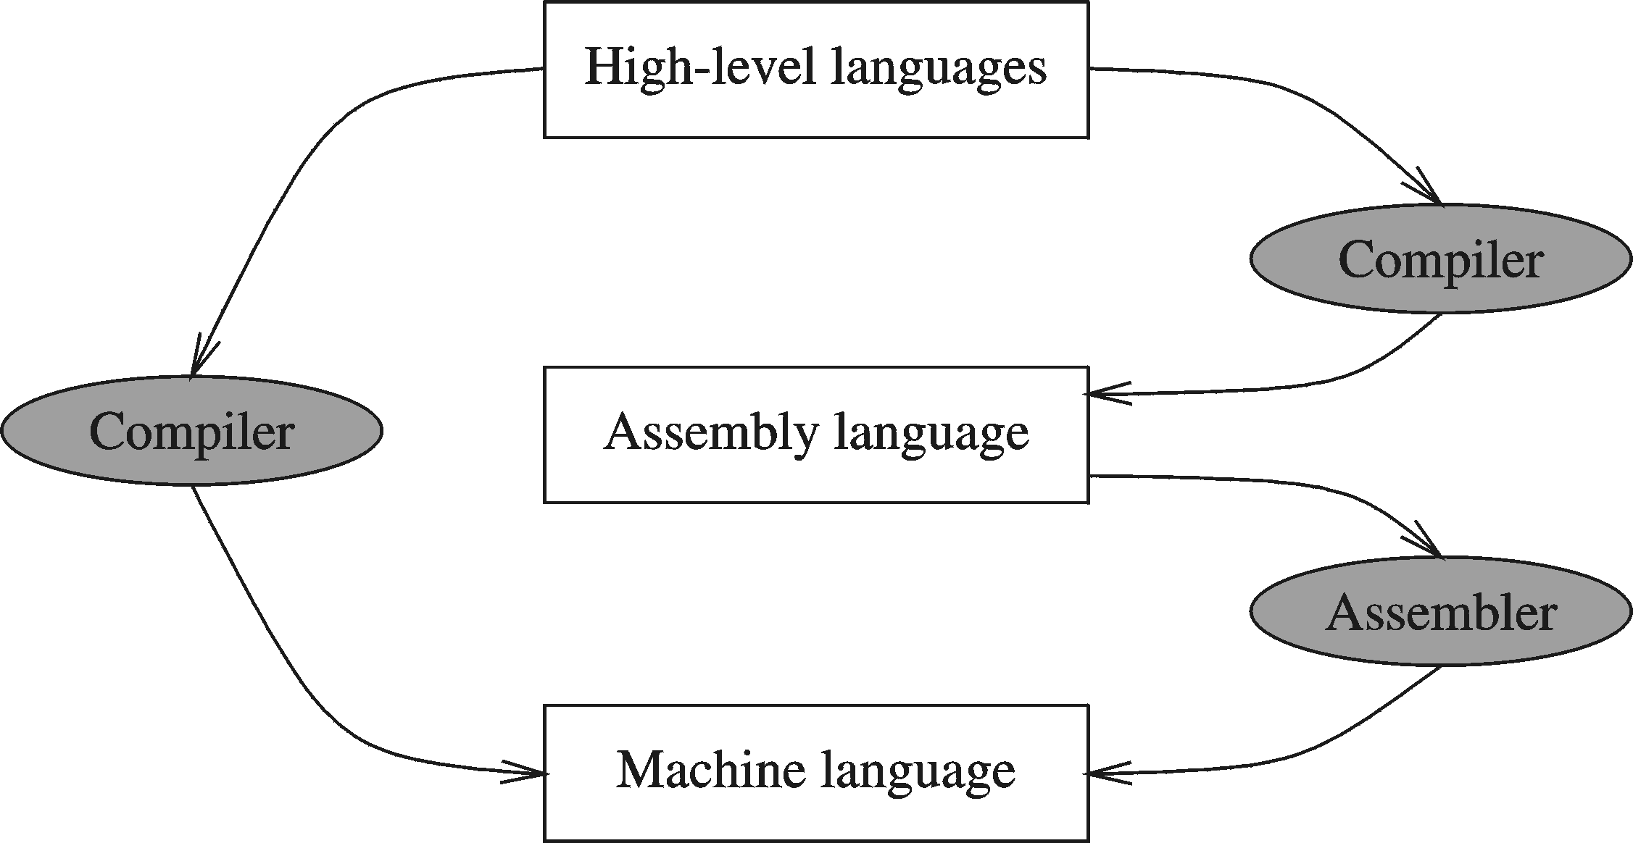
Compiler and Assembler

Slide 14
Translating Languages
English: D is assigned the sum of A times B plus 10.
High-Level Language: D = A * B + 10
A statement in a high-level language is translated typically into several machine-level instructions
Intel Assembly Language:
mov eax, A
mul B
add eax, 10
mov D, eax
Intel Machine Language:
A1 00404000
F7 25 00404004
83 C0 0A
A3 00404008

Slide 15
Translating Languages
These are called instructions, and they specify operations that are to be performed by the processor.
mov is a mnemonic for move,
while mul is a mnemonic for multiply.
Other common instructions include add, sub, and div.
I trust you can figure out what operation these specify!

Slide 16
Translating Languages
Most instructions take two parameters.
In the technical jargon, these are often known as operands.
The first (on the left) is the destination,
and the second (on the right) is the source.
So, in the case of mov bx, 5
this moves the literal value 5 into the destination register bx. The order of these parameters matters, of course, because you could not move the contents of the register bx into the literal value 5!

Slide 17
Translating Languages
The mul instruction is a little bit strange because some of its operands are implicit.
That is, they are not explicitly specified as parameters.
For the mul instruction,
the destination operand is hard-coded as the ax register.
The source operand is the one that you pass as a parameter: it can be either a register or a memory location.

Slide 18
Translating Languages
Therefore, you could imagine that mul cx means
mul ax, cx
but you don't write it that way because the ax destination register is implicit.
Now, a mul instruction commands the processor to multiply the destination operand by the source operand, and store the result in the destination. In code, you can imagine that mul cx would translate into ax = ax * cx.

Slide 19
Translating Languages
If you want to do 5 * 10, then:
mov ax, 5 ; ax = 5
mov cx, 10 ; cx = 10
mul cx ; ax = ax * cx

Slide 20
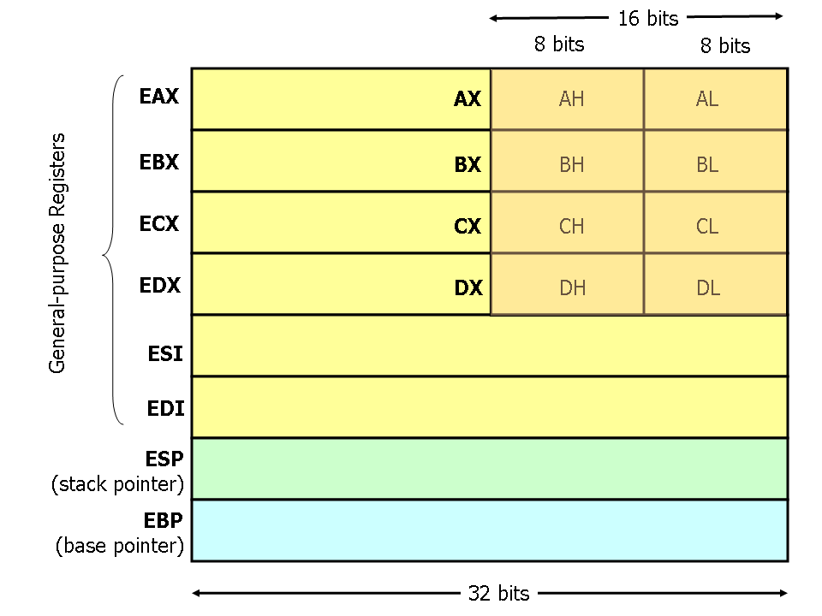
Translating Languages-Registers
Modern (i.e x86 and beyond) x86 processors have eight 32-bit general purpose registers, as depicted in Figure:

Slide 21
Translating Languages-Registers
The register names are mostly historical.
For example, EAX used to be called the accumulator since it was used by a number of arithmetic operations, and
ECX was known as the counter since it was used to hold a loop index.
Whereas most of the registers have lost their special purposes in the modern instruction set, by convention, two are reserved for special purposes — the stack pointer (ESP) and the base pointer (EBP).

Slide 22
Translating Languages-Registers
For the EAX, EBX, ECX, and EDX registers, subsections may be used. For example, the least significant 2 bytes of EAX can be treated as a 16-bit register called AX. The least significant byte of AX can be used as a single 8-bit register called AL, while the most significant byte of AX can be used as a single 8-bit register called AH. These names refer to the same physical register.
When a two-byte quantity is placed into DX, the update affects the value of DH, DL, and EDX. These sub-registers are mainly hold-overs from older, 16-bit versions of the instruction set. However, they are sometimes convenient when dealing with data that are smaller than 32-bits (e.g. 1-byte ASCII characters).

Slide 23
Translating Languages-Registers
When referring to registers in assembly language, the names are not case-sensitive. For example, the names EAX and eax refer to the same register.

Slide 24
General Concepts
Basic Microcomputer Design
data bus
Central Processor Unit (CPU)
Memory Storage Unit
I/O Device #1
I/O Device #2
registers
ALU | CU | clock
control bus
address bus

Slide 25
Basic Architecture
Processor
Control unit
Datapath
ALU
Control
/Status
Controller
Registers
PC
IR
I/O
Memory

Slide 26
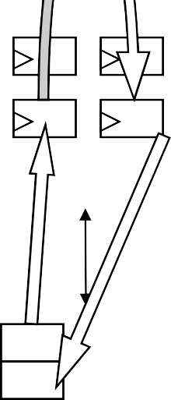
Datapath Operations
Load
– Read memory location into register
ALU operation
Processor
Control unit
Datapath
ALU
Controller
Control
/Status
+1
– Input certain registers through ALU, store
back in register
Registers
Store
– Write register to memory location
10
11
PC
IR
I/O
...
10
.¹.¹.
Memory

Slide 27
Control Unit
Control unit: configures the datapath operations
– Sequence of desired operations (“instructions”) stored in memory – “program”
Processor
Control unit
Datapath
ALU
Instruction cycle – broken into several sub-operations, each one clock cycle, e.g.:
Controller
Control
/Status
Registers
Fetch: Get next instruction into IR
Decode: Determine what the instruction means
Fetch operands: Move data from memory to datapath register
Execute: Move data through the ALU
Store results: Write data from register to memory
PC
IR
R0
R1
I/O
...
10
...
100 load R0, M[500]
inc R1, R0
store M[501], R1
Memory
500
501

Slide 28
Control Unit Sub-Operations
Fetch
Get next instruction into IR
PC: program counter, always points to next instruction
IR: holds the fetched instruction
Processor
Control unit
Datapath
ALU
Controller
Control
/Status
Registers
^{PC}100
IR
R0
R1
load R0, M[500]
I/O
...
10
...
100 load R0, M[500]
inc R1, R0
store M[501], R1
Memory
500
501

Slide 29
Control Unit Sub-Operations
Decode
– Determine what the instruction means
Processor
Control unit
Datapath
ALU
Controller
Control
/Status
Registers
^{PC}100
IR
R0
R1
load R0, M[500]
I/O
...
10
...
100 load R0, M[500]
inc R1, R0
store M[501], R1
Memory
500
501

Slide 30
Control Unit Sub-Operations
Fetch operands
– Move data from memory to datapath register
Processor
Control unit
Datapath
ALU
Controller
Control
/Status
Registers
10
^{PC}100
load R ^{IR}
0, M[500]
R0
R1
I/O
...
10
...
100 load R0, M[500]
inc R1, R0
store M[501], R1
Memory
500
501

Slide 31
Control Unit Sub-Operations
Execute
Move data through the ALU
This particular instruction does nothing during this sub-operation
Processor
Control unit
Datapath
ALU
Controller
Control
/Status
Registers
10
^{PC}100
load R ^{IR}
0, M[500]
R0
R1
I/O
...
10
...
100 load R0, M[500]
inc R1, R0
store M[501], R1
Memory
500
501

Slide 32
Control Unit Sub-Operations
Store results
Write data from register to memory
This particular instruction does nothing during this sub-operation
Processor
Control unit
Datapath
ALU
Controller
Control
/Status
Registers
10
^{PC}100
load R ^{IR}
0, M[500]
R0
R1
I/O
...
10
...
100 load R0, M[500]
inc R1, R0
store M[501], R1
Memory
500
501

Slide 33
Instruction Cycles
PC=100
FetchDecode
Processor
Fetch _{Exec.} ops
Store results
Control unit
Datapath
ALU
clk
Controller
Control
/Status
Registers
10
PC
100
IR
R0
R1
load R0, M[500]
I/O
...
10
...
100 load R0, M[500]
inc R1, R0
store M[501], R1
Memory
500
501

Slide 34
Instruction Cycles
PC=100
FetchDecode
Processor
Fetch _{Exec.} ops
Store results
Control unit
Datapath
ALU
+1
clk
Controller
Control
/Status
PC=101
FetchDecode
Fetch _{Exec.} ops
Store results
Registers
clk
10 11
R1
PC
101
IR
R0
inc R1, R0
I/O
...
10
...
100 load R0, M[500]
inc R1, R0
store M[501], R1
Memory
500
501

Slide 35
PC=100
FetchDecode
Processor
Fetch _{Exec.} ops
Store results
Control unit
Datapath
clk
ALU
+1
Controller
Control
/Status
PC=101
FetchDecode
Fetch _{Exec.} ops
Store results
Registers
clk
IR
10 11
R1
PC
101
inc R1, R0
R0
I/O
...
10
...
100 load R0, M[500]
inc R1, R0
store M[501], R1
Memory
500
501

Slide 36
PC=100
FetchDecode
Processor
Fetch _{Exec.} ops
Store results
Control unit
Datapath
clk
ALU
+1
Controller
Control
/Status
PC=101
FetchDecode
Fetch _{Exec.} ops
Store results
Registers
clk
IR
10 11
bx
PC
101
inc bx, ax
ax
I/O
...
10
...
100 mov ax, M[500]
inc bx, ax
store M[501], bx
Memory
500
501

Slide 37
Instruction Cycles
PC=100
FetchDecode
Processor
Fetch _{Exec.} ops
Store results
Control unit
Datapath
ALU
clk
Controller
Control
/Status
PC=101
FetchDecode
Fetch _{Exec.} ops
Store results
Registers
clk
10 11
R1
PC
102
IR
R0
store M[501], R1
PC=102
FetchDecode
Fetch _{Exec.} ops
Store results
I/O
...
10
¹.¹..
clk
100 load R0, M[500]
inc R1, R0
store M[501], R1
Memory
500
501

Slide 38
Instruction Cycles
PC=100
FetchDecode
Processor
Fetch _{Exec.} ops
Store results
Control unit
Datapath
ALU
clk
Controller
Control
/Status
PC=101
FetchDecode
Fetch _{Exec.} ops
Store results
Registers
clk
10 11
dx
PC
102
IR
cx
store M[501], dx
PC=102
FetchDecode
Fetch _{Exec.} ops
Store results
I/O
...
10
¹.¹..
clk
100 load cx, M[500]
inc dx, cx
store M[501], dx
Memory
500
501

Slide 39
Architectural Considerations
N-bit processor
N-bit ALU, registers, buses, memory data interface
Embedded: 8-bit, 16- bit, 32-bit common
Desktop/servers: 32-
bit, even 64
PC size determines address space
Processor
Control unit
Datapath
ALU
Controller
Control
/Status
Registers
PC
IR
I/O
Memory

Slide 40
Architectural Considerations
Clock frequency
Inverse of clock period (f = 1/T)
Must be longer than longest register to register delay in entire processor
Memory access is often the longest
Processor
Control unit
Datapath
ALU
Controller
Control
/Status
Registers
PC
IR
I/O
Memory

Slide 41
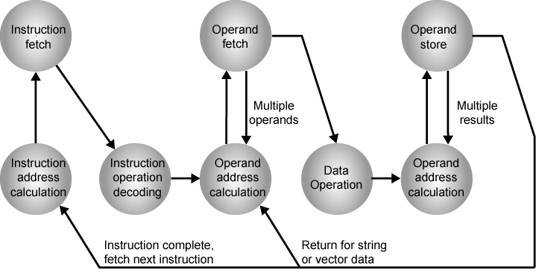
Instruction Cycle State Diagram

Slide 42
Advantages of High-Level Languages
Program development is faster
High-level statements: fewer instructions to code
Program maintenance is easier
For the same above reasons
Programs are portable
Contain few machine-dependent details
Can be used with little or no modifications on different machines
Compiler translates to the target machine language
However, Assembly language programs are not portable

Slide 43
Why Learn Assembly Language?
Two main reasons:
Accessibility to system hardware
Space and time efficiency
Accessibility to system hardware
Assembly Language is useful for implementing system software
Also useful for small embedded system applications
Space and Time efficiency
Understanding sources of program inefficiency
Tuning program performance
Writing compact code

Slide 44
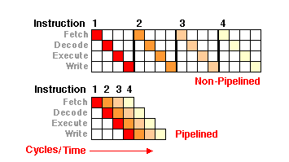
How a pipeline assembly code look like
Notes:
http://www.mackido.com/Hardware/Pipelines.html is the image source

Slide 45
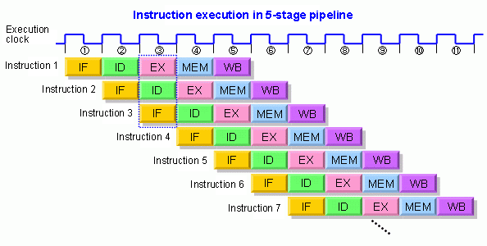
How a pipeline assembly code look like
Notes:
http://www.renesas.eu/support/faqs/faq_results/Q1000000-Q9999999/design/tech/tech_121gl.jsp is the image source

